Slide 1




ADDRESSING
Disaster Recovery and Resilience
The Honorable
Neal Rackleff
Assistant Secretary, Office of Community Planning & Development
U.S. Department of Housing & Urban Development
Follow on Twitter
@RackleffHUD

Slide 2
The People We Serve
15,298 jobs created through CDBG funds
Supportive housing services to 101,043 HIV/AIDS households
100,086 homes created
1.42 million accessed homelessness services
Rental assistance to 17,424 families
$35.4 billion for disaster recovery
COMMUNITY PLANNING
&
DEVELOPMENT
Follow on Twitter
@RackleffHUD
Notes:
Numbers that were reported during calendar year 2017
Housing Units Produced: FY17 HOME & CDBG numbers
Accessed shelter, services, or transitional housing
HOME TBRA and HOPWA TBRA

Slide 3
HUD Disaster Funding Timeline – 2017 Disasters
11/17/17
$5.024 billion awarded to Texas
6/25/18
TX Action Plan Approved
6/28/18
FL Action Plan Approved
2/9/18
$28 billion appropriated
FRN issued for $7.4 billion
8/14/18
FRN for $10B UNMET NEEDS
11/28/17
$616 million awarded to Florida
8/25/17
Harvey hits Texas
FRN for MITIGATION
2017
AUG
SEP
NOV
FEB
APR
JUN
JUL
AUG
SEP
DEC
2018
9/6/17
Irma hits USVI & PR
9/8/17
$7.4 billion appropriated
9/10/17
Irma hits Florida
9/20/18
Maria hits USVI & PR
2/1/18
$1.5 billion awarded to Puerto Rico
4/10/18
$28 billion awarded
7/10/18
USVI Action Plan Approved
7/30/18
PR Action Plan Approved
8/17/18
Texas Grant AgreementSigned
9/20/18
PR Grant Agreement Signed
9/27/18
USVI Grant Agreement Signed
2/2/18
$242.7 million awarded to USVI

Slide 4



2018 Disasters - $1.68 Billion Appropriated So Far
2018
The Worst of the Worst
Hurricanes Florence and Michael
Volcanoes, wildfires, mudslides, tornadoes, hurricanes, typhoons and floods
54 major declared disasters in 35 states

Slide 5
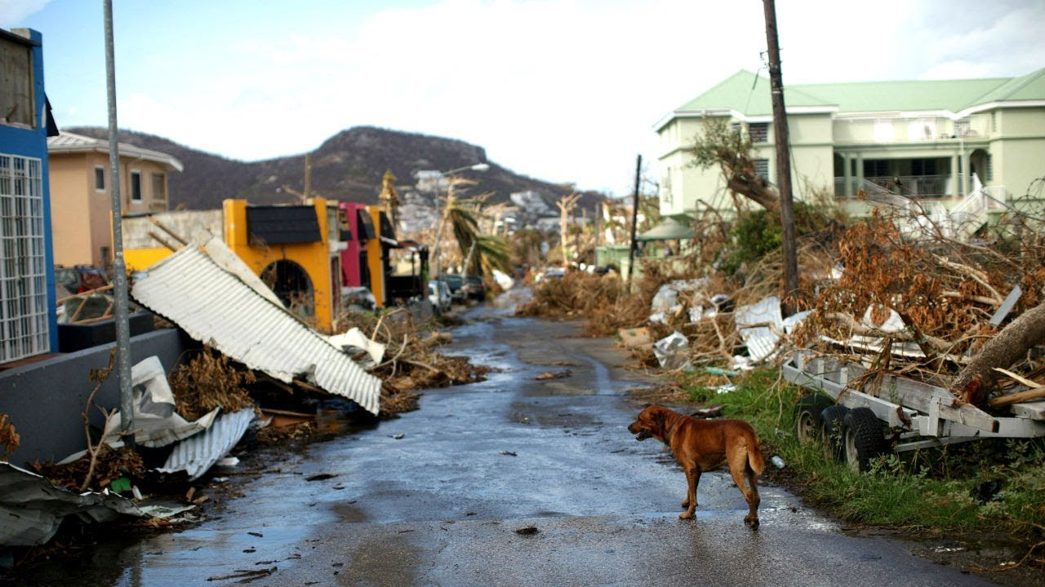
Disaster Recovery Response Process
President declares disaster
FEMA mobilizes; assesses need, provides individual and public assistance
Congress appropriates CDBG Disaster Recovery funds
HUD uses FEMA data to allocate CDBG-DR funds
HUD notifies jurisdiction of fund allocation
Jurisdiction engages community in developing Action Plan for use of funds
Draft Action Plan finalized by State/Grantee
HUD has 45 days to review Action Plan
HUD provides rules via Federal Register Notice
Follow on Twitter
@RackleffHUD

Slide 6
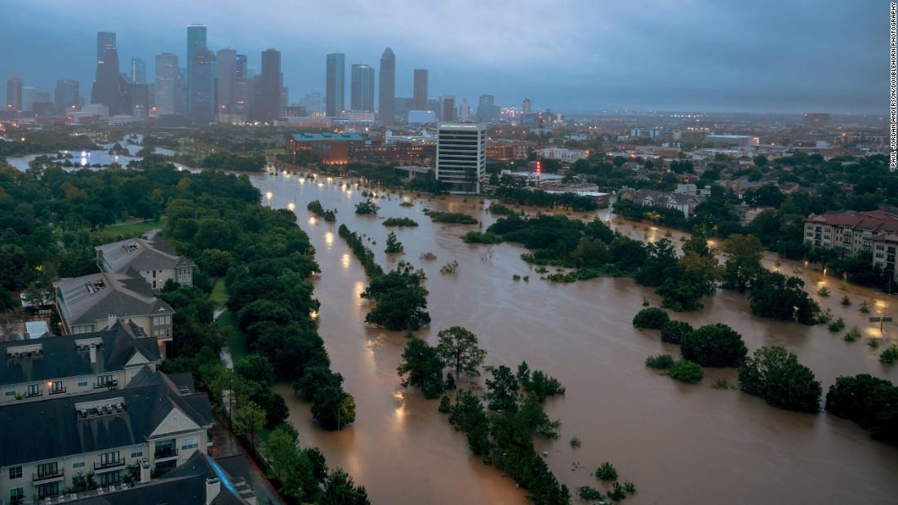
Disaster Recovery Review Process (cont.)
HUD approves Action Plan
HUD issues grant agreement
Agreement executed by State/Grantee
State/Grantee begins implementation
HUD funds project costs
HUD monitors for compliance
HUD rejects Action Plan
Jurisdiction revises and resubmits Plan
Follow on Twitter
@RackleffHUD

Slide 7
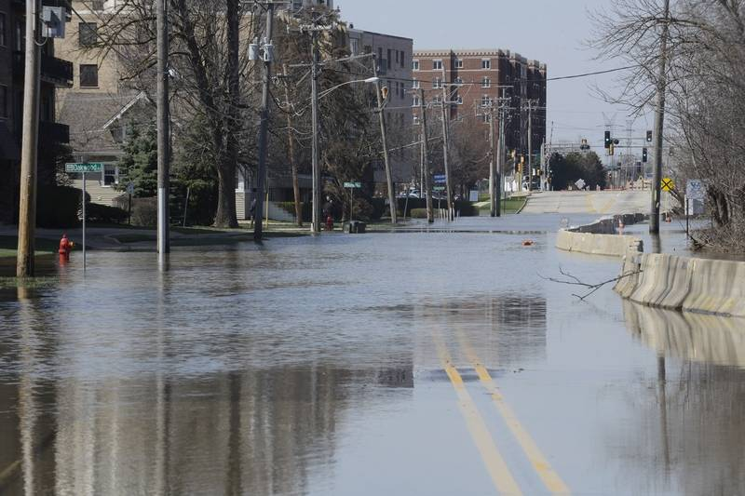
Disaster Recovery
Harvey/Maria/Irma
First Appropriation – 2017 $ 7.40 Billion
Second Appropriation – 2018 $27.97 Billion
Total $35.37 Billion
Follow on Twitter
@RackleffHUD

Slide 8
Initial $7.4 Billion CDBG-DR Funds for 2017 Disasters
Florida
$616 million
U.S. Virgin Islands
$243 million
Texas
$5.024 billion
$1.5 billion
Puerto Rico
Follow on Twitter
@RackleffHUD
Notes:
State of Texas ................. $5,024,215,000
State of Florida ................ $615,922,000
Commonwealth of Puerto Rico……..$1,507,179,000
United States Virgin Islands……….$242,684,000
TOTAL………$7,390,000,000
Source: Feb 9, 2018 FRN

Slide 9
Identifying Unmet Needs
Repair estimates for seriously damaged owner-occupied units without insurance after FEMA and SBA repair grants or loans
Repair estimates for seriously damaged rental units of renters with income below 50% of AMI
Repair and content loss estimates for small businesses with serious damage denied by SBA
Notes:
For disasters that meet the most impacted threshold described above, the unmet need allocations are based on the following factors summed together less previous CDBG-DR allocations for the 2017 disasters unmet needs:
Repair estimates for seriously damaged owner-occupied units without insurance (with some exceptions) in most impacted areas after FEMA and SBA repair grants or loans;
Repair estimates for seriously damaged rental units occupied by renters with income less than 50% of Area Median Income in most impacted areas;
Repair and content loss estimates for small businesses with serious damage denied by SBA;
The estimated local cost share for Public Assistance Category C to G projects;
$2 billion for Maria impacted disasters for improvements to the electric grid

Slide 10
Calculating Unmet Housing Needs
Number of housing units with unmet needs
Repair funds already provided by FEMA and SBA
Estimated cost to repair the units
PLUS
LESS
Follow on Twitter
@RackleffHUD

Slide 11
$28 Billion in CDBG-DR for 2015-2017 Disasters
Unmet Needs
2017 Only
“No less than” $12 billion
“Up to” $16 billion
Not More Than $16 B
Left from Unmet Needs ($3.9 B)
Total Unmet Needs $12.1 B
$11 billion
minimum to Puerto Rico/Virgin Islands
including
$2 billion
for the electrical grid
No Less Than $12 B
Left from Unmet Needs $3.9 B
Total Mitigation $15.9 B
Follow on Twitter
@RackleffHUD
Notes:
Funds allocated to grantees in 11 states for disasters in 2015, 2016 and 2017.

Slide 12

Community Development Block Grants – The Statute
CDBG Purpose:
Decent housing, suitable living environment, and economic opportunities for persons of low and moderate income; community development activities which may be supported by Federal assistance.
…not less than 70 percent of the aggregate of the Federal assistance provided to States and units of general local government under section 106 [42 USCS § 5306]…shall be used for the support of activities that benefit persons of low and moderate income
42 USCS § 5301(c)

Slide 13
2017 Appropriations for 2015-2017 Disasters
Disaster Year | Grantee | 2017 Unmet Needs | Electrical Grid | Mitigation | Second Appropriation PL 115-123 | First Appropriation PL 115-56
2015 | Columbia SC | $ - |  | $ 18,585,000.00 | $ 18,585,000.00 | $ -
2015 | Houston, TX | $ - |  | $ 61,884,000.00 | $ 61,884,000.00 | $ -
2015 | Lexington County SC | $ - |  | $ 15,185,000.00 | $ 15,185,000.00 | $ -
2015 | Richland County, SC | $ - |  | $ 21,864,000.00 | $ 21,864,000.00 | $ -
2015 | San Marcos, TX | $ - |  | $ 24,012,000.00 | $ 24,012,000.00 | $ -
2015 | South Carolina | $ - |  | $ 90,026,000.00 | $ 90,026,000.00 | $ -
2015 | Texas | $ - |  | $ 52,985,000.00 | $ 52,985,000.00 | $ -
2016 | Florida | $ - |  | $ 83,801,000.00 | $ 83,801,000.00 | $ -
2016 | Louisiana | $ - |  | $ 1,213,917,000.00 | $ 1,213,917,000.00 | $ -
2016 | North Carolina | $ - |  | $ 168,067,000.00 | $ 168,067,000.00 | $ -
2016 | South Carolina | $ - |  | $ 67,564,000.00 | $ 67,564,000.00 | $ -
2016 | Texas | $ - |  | $ 169,748,000.00 | $ 169,748,000.00 | $ -
2016 | West Virginia | $ - |  | $ 106,494,000.00 | $ 106,494,000.00 | $ -
2017 | California | $ 124,155,000.00 |  | $ 88,219,000.00 | $ 212,374,000.00 | $ -
2017 | Florida | $ 157,676,000.00 |  | $ 549,684,000.00 | $ 707,360,000.00 | $ 615,922,000.00
2017 | Georgia | $ 37,943,000.00 |  | $ 26,961,000.00 | $ 64,904,000.00 | $ -
2017 | Missouri | $ 58,535,000.00 |  | $ 41,592,000.00 | $ 100,127,000.00 | $ -
2017 | Puerto Rico | $ 8,220,783,000.00 | $ 1,932,347,000 | $ 8,285,284,000.00 | $ 18,438,414,000.00 | $ 1,507,179,000.00
2017 | Texas | $ 652,175,000.00 |  | $ 4,074,456,000.00 | $ 4,726,631,000.00 | $ 5,024,015,000.00
2017 | U.S. Virgin Islands | $ 779,217,000.00 | $ 67,653,000 | $ 774,188,000.00 | $ 1,621,058,000.00 | $ 242,684,000.00
TOTAL |  | $ 10,030,484,000.00 | $ 2,000,000,000 | $ 15,934,516,000.00 | $ 27,965,000,000.00 | $ 7,390,000,000.00

Slide 14

Housing affordability is at the lowest level since just before the housing crisis hit.
- National Association of Homebuilders, Aug. 9, 2018
A Crisis in America
Homelessness is rising, 40% of Americans can’t afford basic necessities, and 38% of renters spend more than 1/3 of their income on housing.
- Curbed, Aug. 10, 2018

Slide 15
Factors Behind the Affordable Housing Crisis
Shortage of homes
Increasing rents and home values
Income growth not keeping pace
Demand exceeds housing supply
Restrictive land use policies
NIMBY resistance
Follow on Twitter
@RackleffHUD

Slide 16
Findings of 2018 Harvard Housing Report
RENTERS
HOMEOWNERS
From 1990-2016
From 1990-2016
Median rent rose 20% faster than overall inflation
Median home price rose 41% faster than overall inflation
38.1 million households spend more than 30% of their income on housing
From 1960-2016
From 1960-2016
Rent
Payment
Renter
Income*
Home
Value
Owner
Income*
*Adjusted for inflation
*Adjusted for inflation
112%
20%
50%
5%
Notes:
The 2018 Harvard Housing Report found a pretty dire story for both renters and homeowners.
On the renter side, from 1990 to 2016, the national median rent rose 20% faster than overall inflation. For homeowners, the home price rose 41% faster than inflation.
From 1960 to 2016:
Median rent payment rose 61% while the median renter income grew only 5% (adjusted for inflation).
Median home values increased 112% nationally, but median owner income grew only 50% (adjusted for inflation).

Slide 17

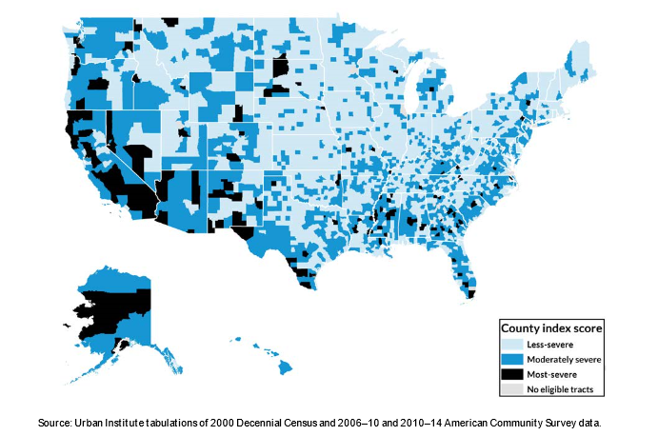
Rental Housing for a 21st Century Rural America
Study Released October 2, 2018
Most Severe Need
Over 150 rural counties
7% of rural population
Moderately Severe Need
38% of rural counties
42% of rural population
Notes:
This study focused on the role of housing supply, demand and affordability to assess future production needs for affordable rental housing in rural areas. Rural counties were defined as those eligible for USDA housing programs. The study looked at housing supply, housing demand and housing affordability in the eligible counties, and analyzed 7 key indicators to form an index of county-level severity of need for affordable rental housing production:
Housing supply
(1) A rental housing vacancy rate of less than 5% and (2) a share of federally subsidized rental units less than 5%
Housing demand
(3) A rate of population growth greater than 10% between 2000 and 2014, (4) greater than 20% persistent poverty rate, (5) an unemployment rate persistently higher than the national average, and (6) a share of overcrowded housing greater than 3%.
Affordability
(7) A share of severely cost-burdened households greater than 25%.
Taken together, these indicators highlight those eligible rural areas facing relatively short supply, growing or strong demand, and affordability challenges compared with other areas. Eligible counties scored 1 point for each indicator threshold for severity that they met for a total possible score of 7 points. Based on its index score, each county was sorted into one of three categories:
Most-severe need (score of 4 through 7)
Moderately severe need (score of 2 or 3)
Less-severe need (score of 0 or 1)

Slide 18
Is Housing Assistance Meeting Housing Needs?
% Renters With Worst-Case Need
Renters below 50% of Area Median Income who do not get housing assistance and pay more than half of their income towards rent.
Follow on Twitter
@RackleffHUD
Notes:
Define “renters with worst-case need” before comparing the percentage of renters who have worst-case needs to the percentage of renters receiving housing assistance.
Worst-case needs: Renters with very low incomes (below 50% of Area Median Income) who do not get housing assistance and who pay more than half of their income towards rent.
The West has the highest instances of worst-case need but lowest housing assistance available to renters

Slide 19
Is Housing Assistance Meeting Housing Needs?
% Renters With Worst-Case Need
  The West has the highest instances of worst-case need but lowest housing assistance available to renters
% Renters Receiving Housing Assistance
Follow on Twitter
@RackleffHUD
Notes:
This chart compares the percentage of renters who have worst-case needs to the percentage of renters receiving housing assistance.
Worst-case needs: Renters with very low incomes (below 50% of Area Median Income) who do not get housing assistance and who pay more than half of their income towards rent.
The West has the highest instances of worst-case need but lowest housing assistance available to renters

Slide 20

Homelessness in America – 2017
INDIVIDUALS
FAMILIES
2017 point-in-time count: 553,742
Homelessness Among Individuals: Up .7% since 2016; Down 13% since 2010
Homelessness Among Families:
Down 27% since 2010
Notes:
Total homeless persons counted in the 2017 PIT count: 553,742 (an increase of .7% since 2016)
2017 total unsheltered: 192,875
Homelessness Among Families - 2017 Total: 57,971
2017 Unsheltered: 5,142
Source: USICH April Board presentation

Slide 21

Veteran Homelessness in America – 2018
Total homeless veterans: 37,887 Down 5.4% since 2017
Female homeless veterans: 3,219
Down 9.8% since 2017
Since 2010
Veteran Homelessness Down 49%
This Photo by Unknown Author is licensed under CC BY-SA
10

Slide 22
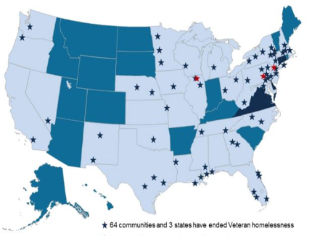
Veteran Homelessness in America – 2018
64 communities and 3 states have ended veteran homelessness
3 communities have ended chronic homelessness
States that have at least one community that has ended homelessness

Slide 23

1 in 10
The Los Angeles Story
2017
Up 66% since 2010
Up 25.8% since 2016
Homeless Americans living in Los Angeles
55,188 total
Follow on Twitter
@RackleffHUD
Notes:
Homelessness in LA up 25.8% from 2016 to 2017.

Slide 24
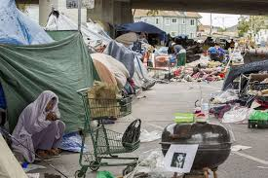
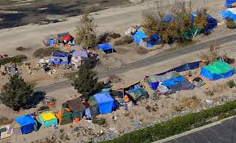
Santa Ana River Trail

Slide 25
HUD’s Commitment to Ending Homelessness
2017 Continuum of Care
Program Competition
$2 billion
awarded to
7,243 projects
2018 Continuum of Care
Program Competition
$2.1 billion
available
Applications currently
under review

Slide 26
For More Information
HUD.gov/program_offices/comm_planning/
HUDexchange.info
Follow on Twitter
@RackleffHUD

